Slide 1
Word Association and Lexical Properties
Maddie Fletcher, Miles Keppler, Hailey Smith

Slide 2
Background
Pajek Data Set: The Edinburgh Associative Thesaurus (EAT)
The initial group was presented with a list of words (stimuli) in a nucleus set. Asked to write down the first word that came to mind after reading each word in the set.
Then the process was repeated with the responses becoming the new stimuli
But only 3 times due to data set getting too large (Done by hand)
100 stimulus words shown to every subject
Nucleus word set based off “1000 most frequent words” and Ogden vocabulary
The 100 subjects were mostly undergraduates from a variety of British Universities
Age Range: 17-22
64% Male, 36% Female
Notes:
1000 most frequent words - Thorndike and Lorge (1944) (self explanatory)
Ogden vocabulary was a collection of words meant to be the “core” of the language - 90% of english was represented with these 850 ‘simple’ words. ”Take away redundancies of our language that can be made by putting together simpler words” http://ogden.basic-english.org/

Slide 3
Motivation
Why did we pick this?
How do people relate words?
Examine the prominence of certain English words
What could we learn from this?
The frequency of central words
Do central words have similar lexical properties (i.e Length)
Words are cool
We use them every day
Speaking
Thinking
Writing
Notes:
Maddie does this one

Slide 4
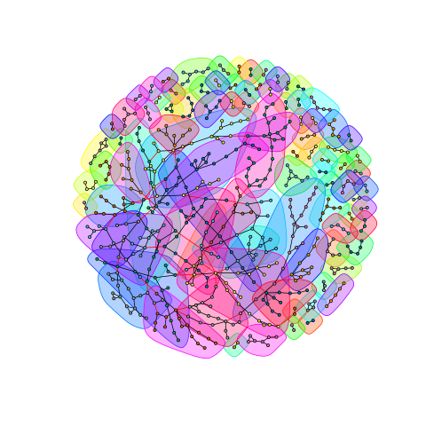
Initial Analysis
Initial data set was too large
23,000 nodes
325,000 edges
Visually was a blob
New data set examined the top 5%
Eliminated nodes with zero in-degree
Used R iGraph
Eventually went back to big data set
iGraph is fast
Communities from Louvain Algorithm in R

Slide 5
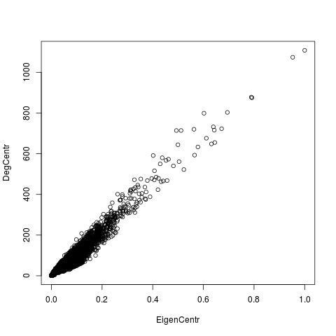
Relevant Measures
Degree Centrality
Represents how many times that node was a response to any stimulus
Eigenvector Centrality
How likely that word is to be thought of in response to any stimulus.
Prominence of a word
This is our main focus
Clustering Coefficient: 0.062
A lot of two-word pairs that weren’t connected to rest of graph

Slide 6
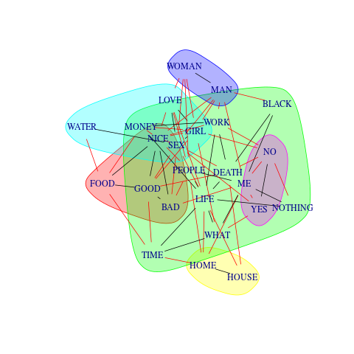
Top Tenth of a Percent Visualized
Nothing | Bad | Water | Man | Yes | Home
Black | Food | Sex | Woman | No | House
Me | Good | Love
Death | Nice | Girl
Life
People
What
Time
Work
Money

Slide 7
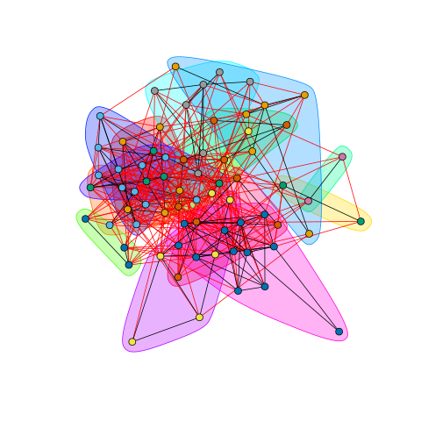
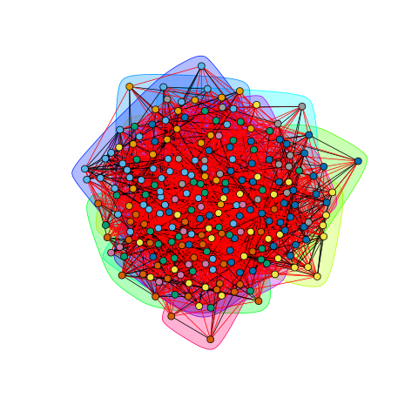
More Clusters

Slide 8
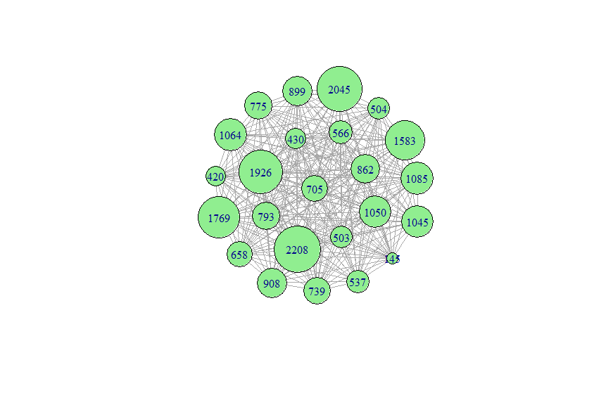
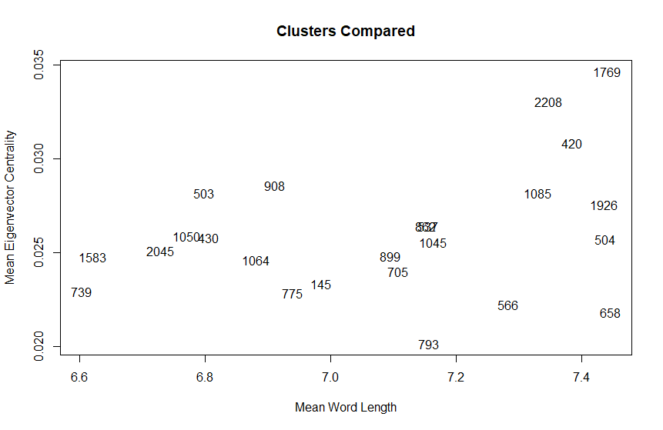
Louvain Clustering
Louvain forces undirected
Fully connected communities
Diameter = 1
24 groups
Mod = 0.48
216307/305502 ~ 70.8% of edges are crossing edges
Range from 145 to 2208 words per community
Unfortunately, this would be a great part to have sentiment analysis
And other word measures
537, 862

Slide 9
Centrality and Lexical Analysis
Hypothesis:
Length inversely proportional to centrality
Shorter words more likely to be thought of
Findings
Word length predicts more than 95% of the variation in eigenvector centrality within words of a given length
Mostly between ~5 and 15 characters
Very insignificant in finding the centrality of a given word
Explains about 1% of individual word variation

Slide 10
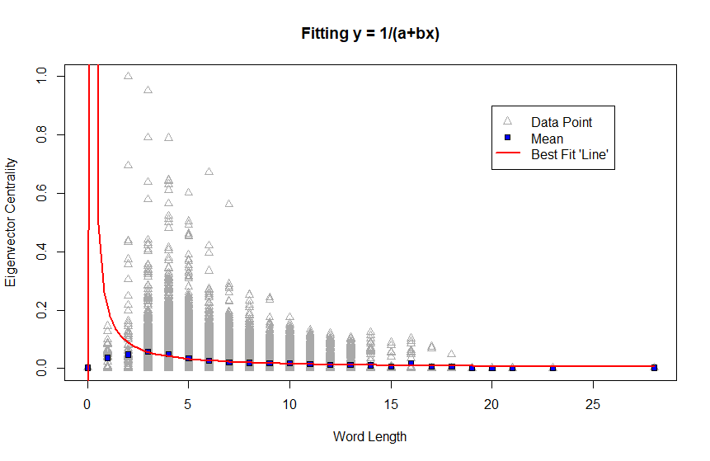

Slide 11
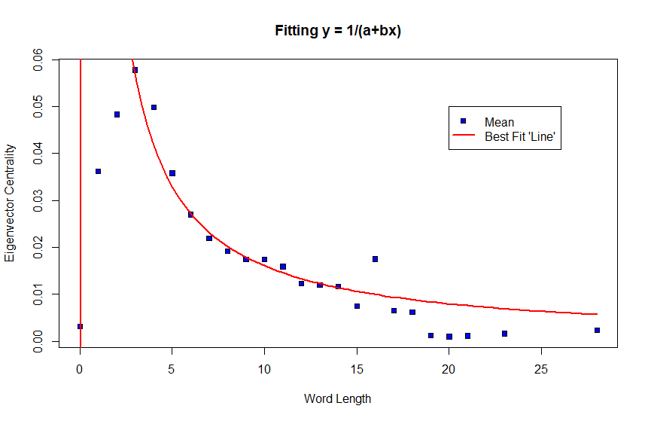

Slide 12
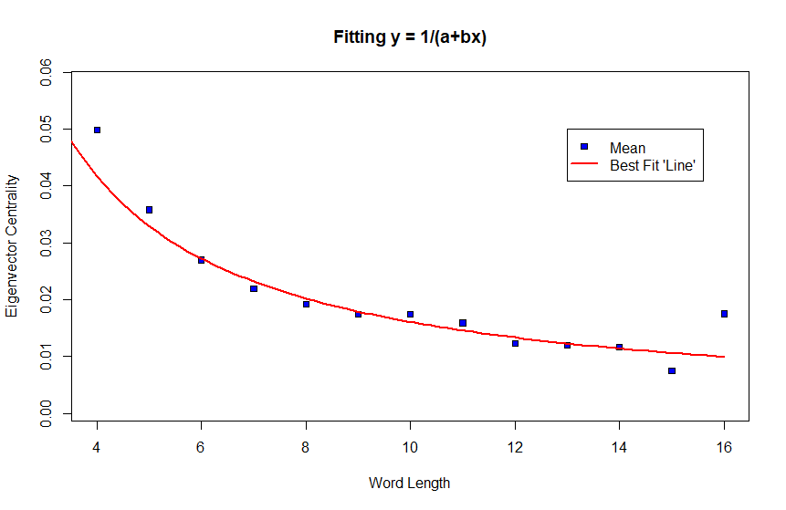

Slide 13
Eigenvector Centrality Interpreted
ME | 1
MAN | 0.9527155401
SEX | 0.7917754359
GOOD | 0.7890699237
NO | 0.6947225344
PEOPLE | 0.6718971912
LIFE | 0.6449757211
WORK | 0.6428889113
YES | 0.639259786
LOVE | 0.6316908639
TIME | 0.6117044179
MONEY | 0.6024431479
BAD | 0.5783801614
GIRL | 0.5651795734
NOTHING | 0.5628757937
NICE | 0.5228484965
FOOD | 0.5119273303
DEATH | 0.5039227806
WHAT | 0.4994750696
WATER | 0.4934378117
HOME | 0.4815968847
HOUSE | 0.4621125635
WOMAN | 0.4566632349
BLACK | 0.4525346595
Total eigenvector centrality = 622.4489
The proportion of the time that we’d expect you to think of a given word is that word’s eigenvector centrality divided by the total eigenvector centrality of all nodes in the graph
This means that we can expect the most popular word (“me”) to be thought of about .16% of the time
Very few words have >.5

Slide 14
Conclusion
Shorter words (about 5 letters) are more likely to be thought of on average
Phrases are less likely to be thought of, more so than just extra letters
Frequency has no correlation in the top percentiles
It is easy to get from one group of words to another through association

Slide 15
Word Association and Lexical Properties
Maddie Fletcher, Miles Keppler, Hailey Smith

Slide 16
Application
People think of and use shorter words more often
Use shorter words in marketing (Got Milk, etc.)
Use shorter company names (Google, Sharpie, etc.)
Keep your product/brand associated with small words
Use a slogan that has words like “me” and “man” in it

